Slide 1

BAN 210 – FINAL ASSESSMENT
BREAST CANCER DATA
Submitted By: Amish Gupta
Student ID: 157547217

Slide 2
Agenda
OBJECTIVES
PROCESS FOLLOWED FOR CONDUCTING THE ANALYSIS
RESULTS RECEIVED FOR THE TARGET VARIABLES
DECISION TREE
NEURAL NETWORK
MODEL COMPARISON AND CONCLUSION

Slide 3

OBJECTIVES
To find the overall classification of the target variables which during the initial phase of the analysis was taken as recurrence events and no-recurrence events
Which model is better in delivering the results (Decision tree or Neural Network)

Slide 4
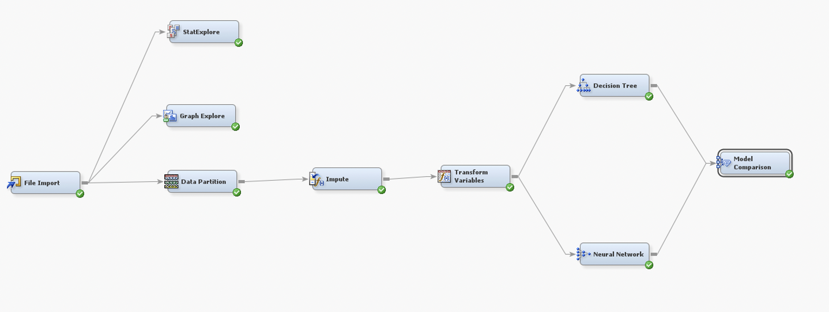
PROCESS FOLLOWED FOR CONDUCTING THE ANALYSIS
EDA (Exploratory Data Analytics) Stages are:
File import
Stat Explore
Graph Explore
Data Partition
Impute
Transform Variables
Predictive Analytics (Model Building) Stages :
Decision Tree
Neural network
Model Comparison

Slide 5
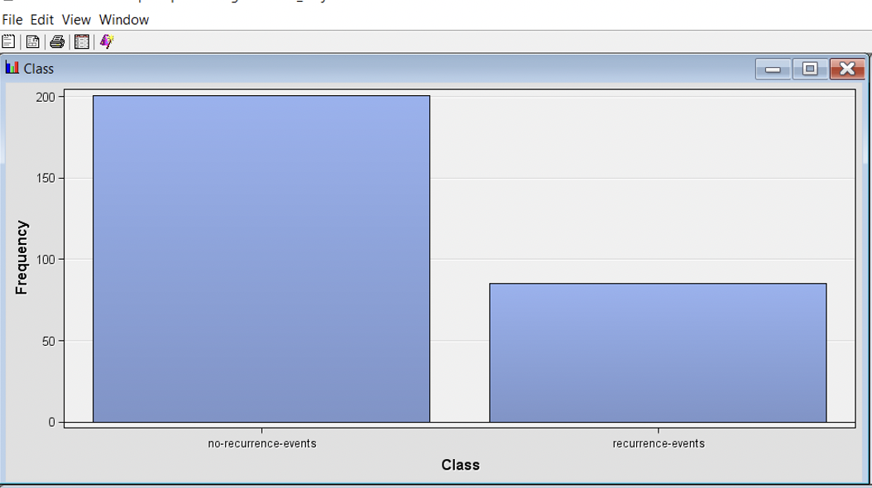
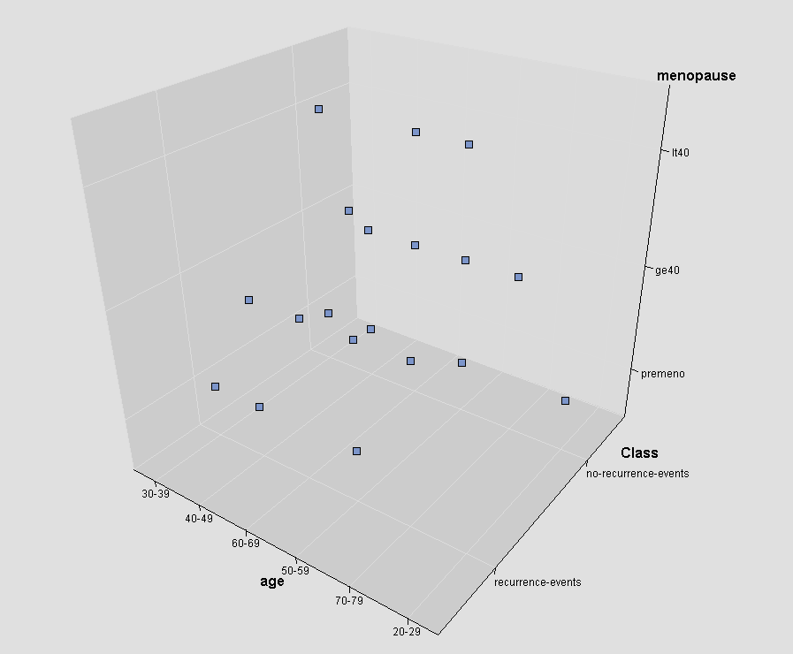
RESULTS RECEIVED FOR THE TARGET VARIABLES- GRAPH EXPLORE
RESULTS RECEIVED FOR THE TARGET VARIABLES- GRAPH EXPLORE
The results that are obtained after checking out the frequency distribution of the target variable that is class is 86 which is recurrence events
The scatter plot which is shown is 3D representation of the variables where X is class Y is age and Z is menopause

Slide 6
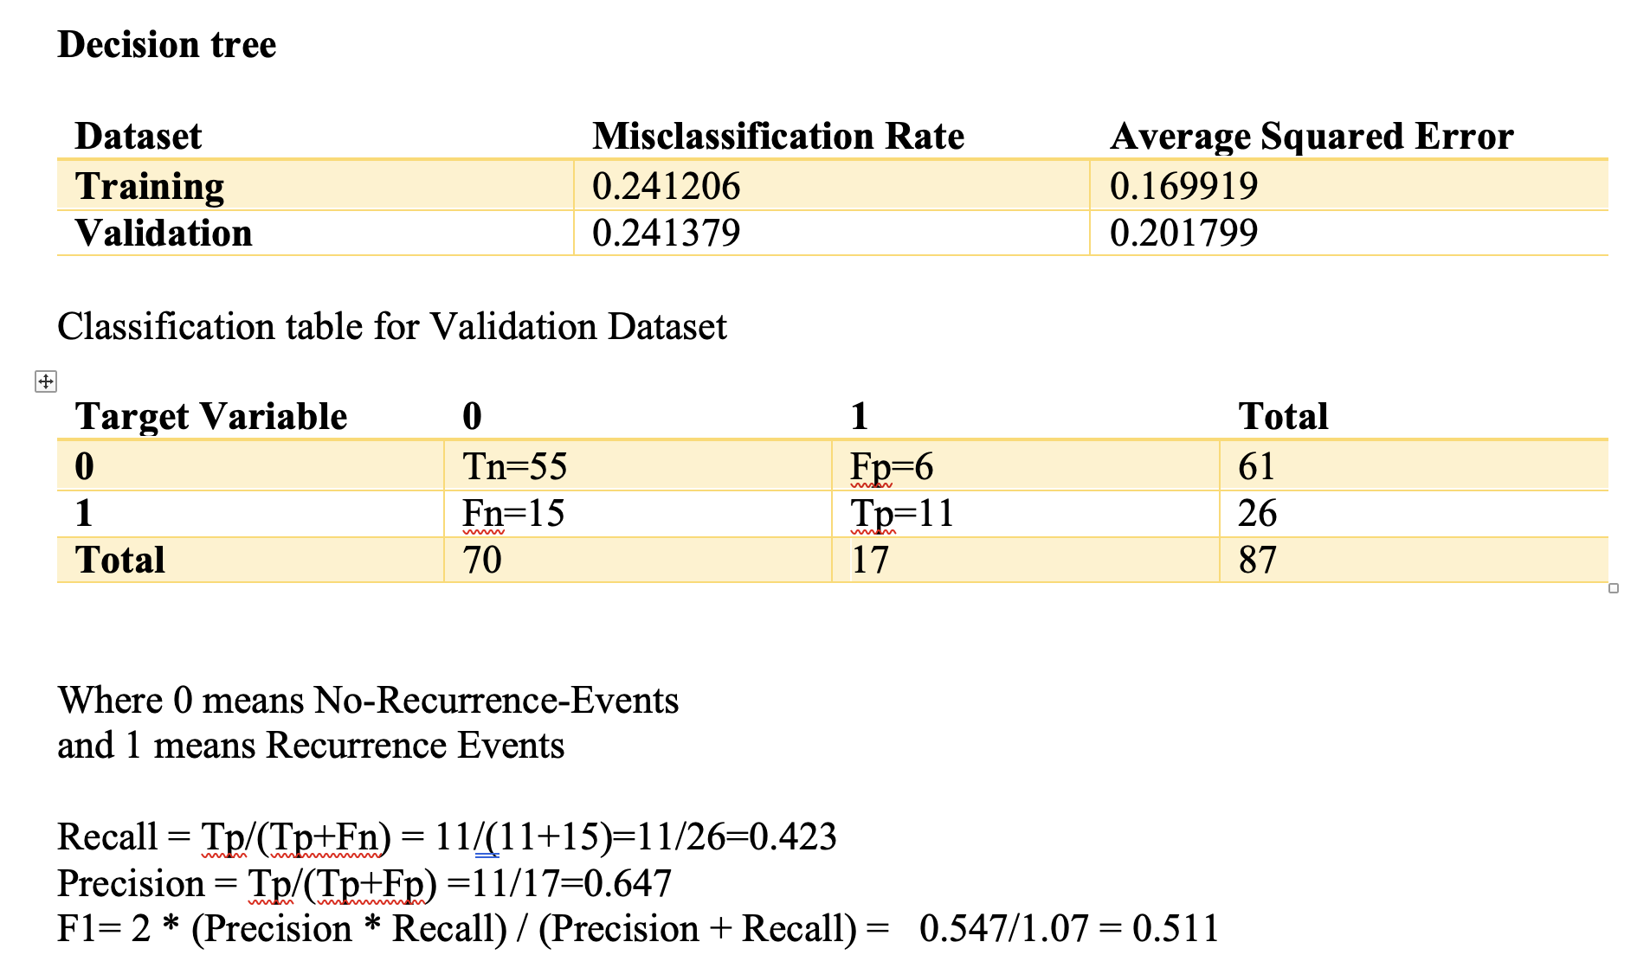
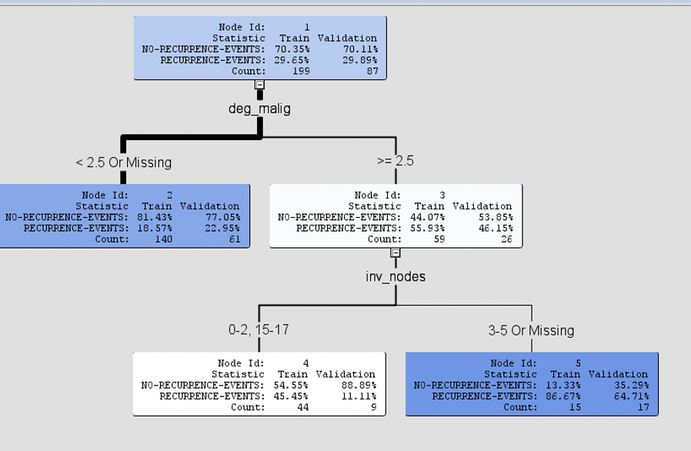
DECISION TREE
The F1 Score is used to calculate the overall accuracy of the model as it uses both the Recall and the precision to calculate the overall output.
The F1 score for this case is 0.511

Slide 7
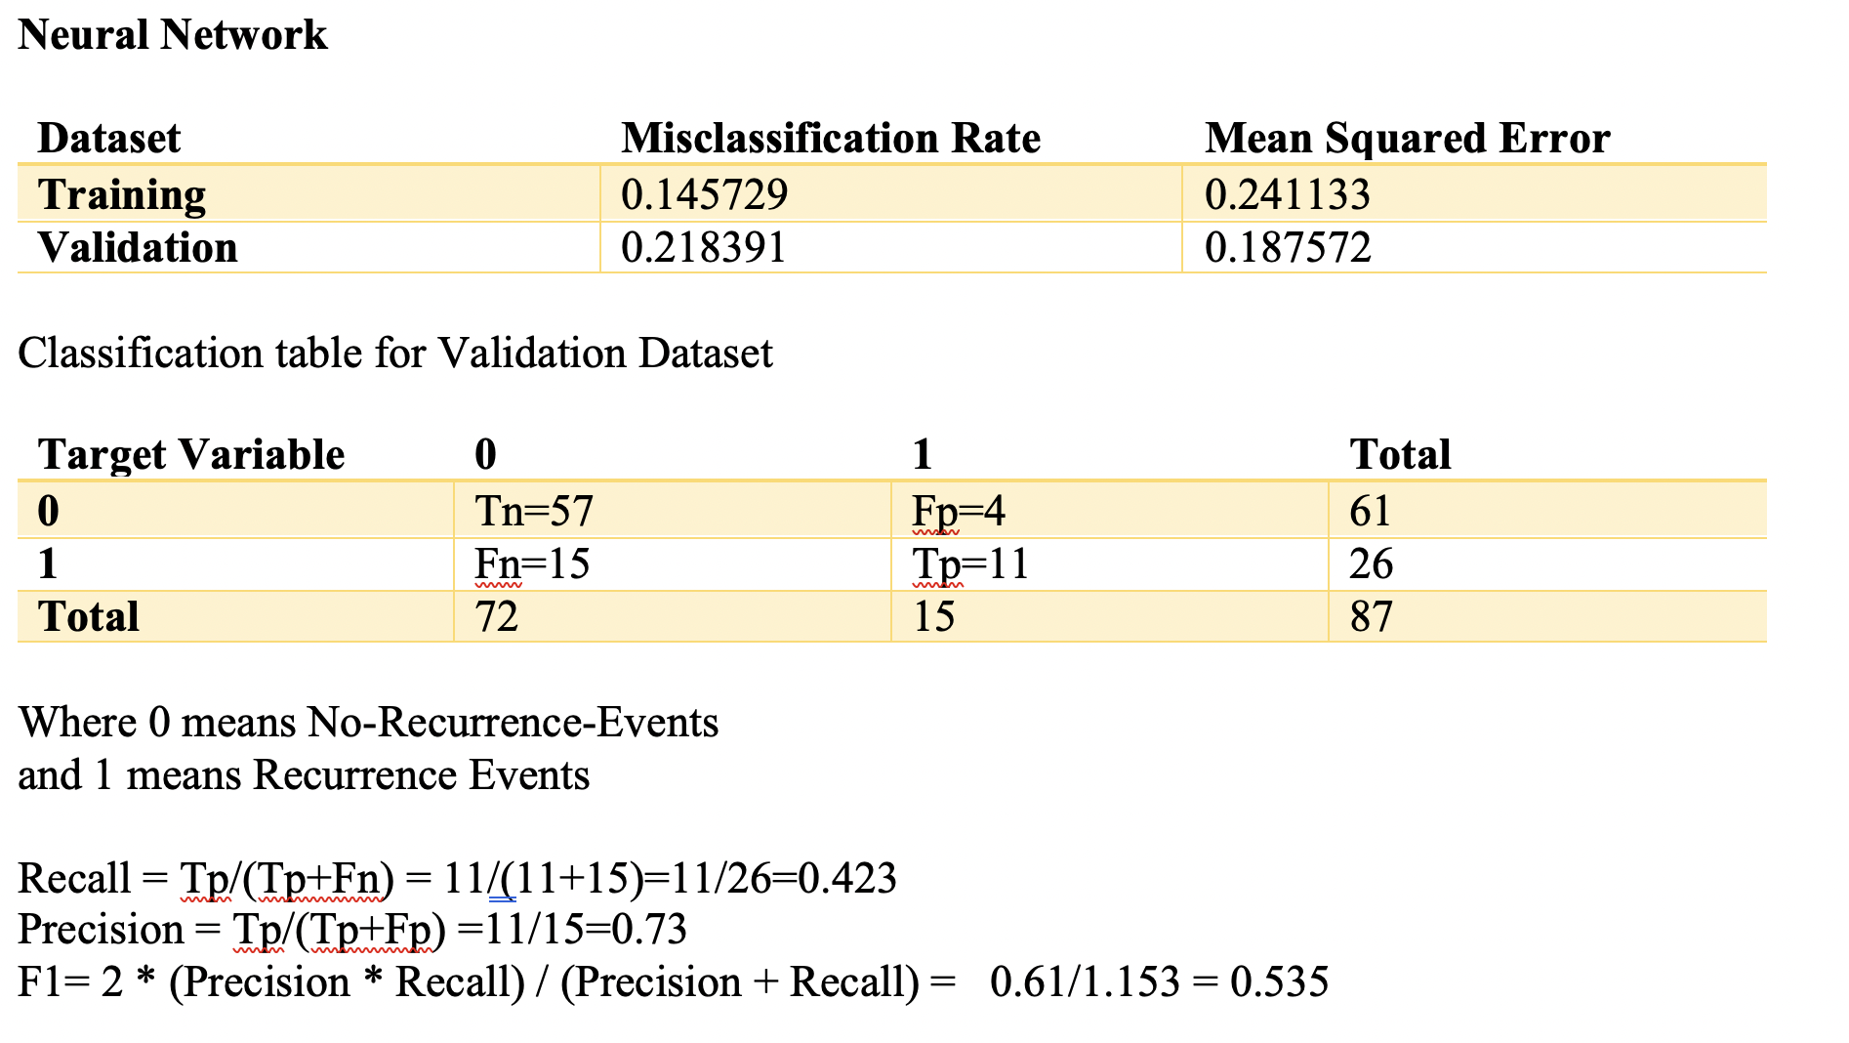
NEURAL NETWORK
The F1 Score for this case is 0.535

Slide 8
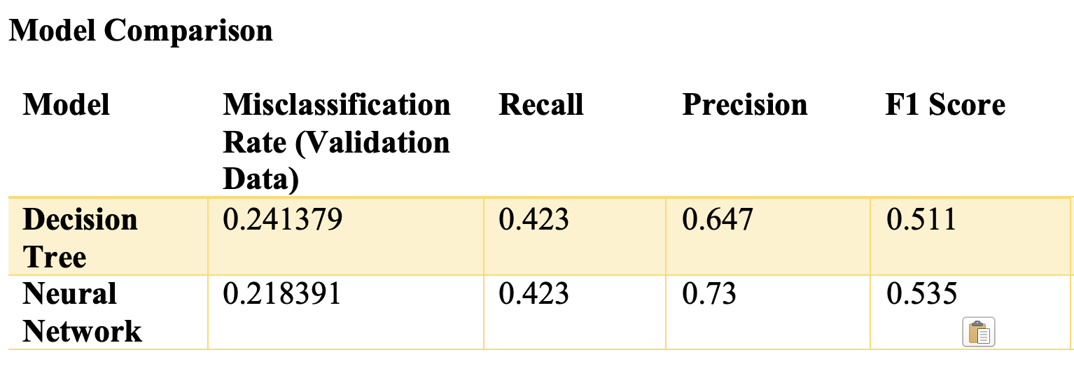
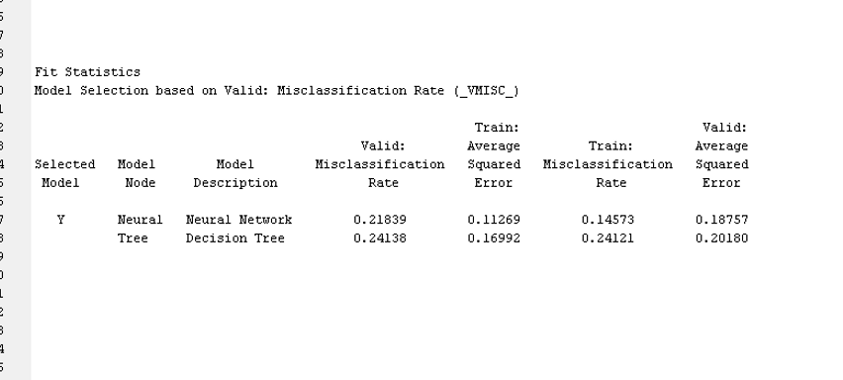
MODEL COMPARISON
On comparing both the models it is evident that the neural network is a better model than the decision tree as the F1 Score of the Neural network is higher in comparison to the decision tree.
Moreover, the results that were obtained from the Model comparison node is as shown, here also neural network is selected as a model with better accuracy

Slide 9
Conclusion
Neural network has a better output in score ranking performance in which the validation data set is sorted and arranged in the format of descending order. Due to this reason also, we can say that the Neural network can be considered as a better model in comparison to the decision tree

Slide 10


